Slide 1


VolunteerSync: Volunteer Management Platform
A Web Platform for Volunteer Engagement & Event Management
Technologies: React (Frontend) | ASP.NET Core C# (Backend)
by Uwase Belise

Slide 2

Problem Statement
Volunteer Management Challenges
Volunteer Discovery
Tracking & Certification
No centralized system to find matching events
No standard way to track hours or issue certificates
Manual processes cause errors and missed opportunities

Slide 3
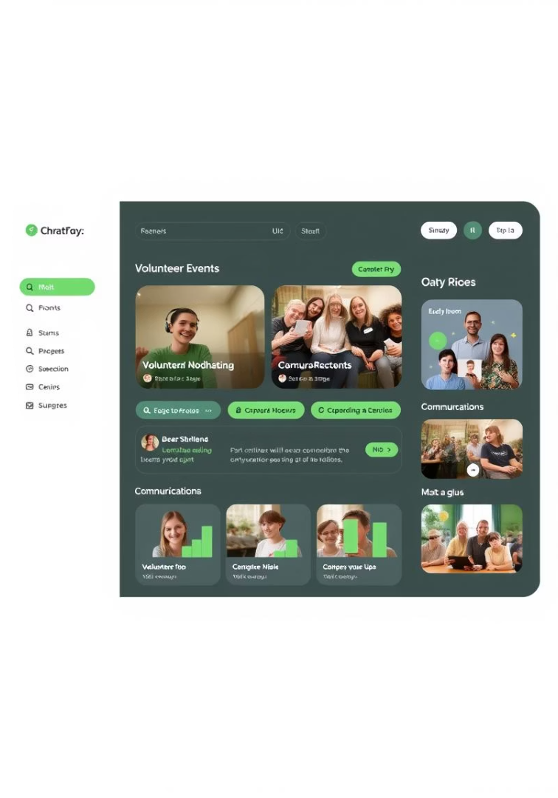
Proposed Solution – VolunteerSync
All-in-One Platform
Connects volunteers and organizations
Event Management
Create, register, track, and give feedback
User Dashboards
For volunteers, organizations, and admins
Real-Time Communication
Built-in reminders and messaging

Slide 4
Key Features for Volunteers
Profile & Registration
Event Interaction
Participation Tracking
Build personal profile
Browse/filter events
View history
Register for events
Receive confirmations
Download certificates
Rate and give feedback

Slide 5
Key Features for Organizations
Event Management
Volunteer Coordination
Reporting
Create/manage events
View volunteer lists
Export reports
Approve volunteer applications
Mark attendance
Issue digital certificates
Send updates

Slide 6

Key Features for Admin
User Management
Content Moderation
Manage accounts, approve/block organizations
Remove inappropriate content or events
Analytics & Settings
View system data, configure notifications

Slide 7
User Roles & Responsibilities
Admin
Organization
Volunteer
Platform oversight
Create/manage events
Browse and join events
User management
Communicate with volunteers
Track activity
Content moderation
Feedback and reporting
Receive certificates

Slide 8
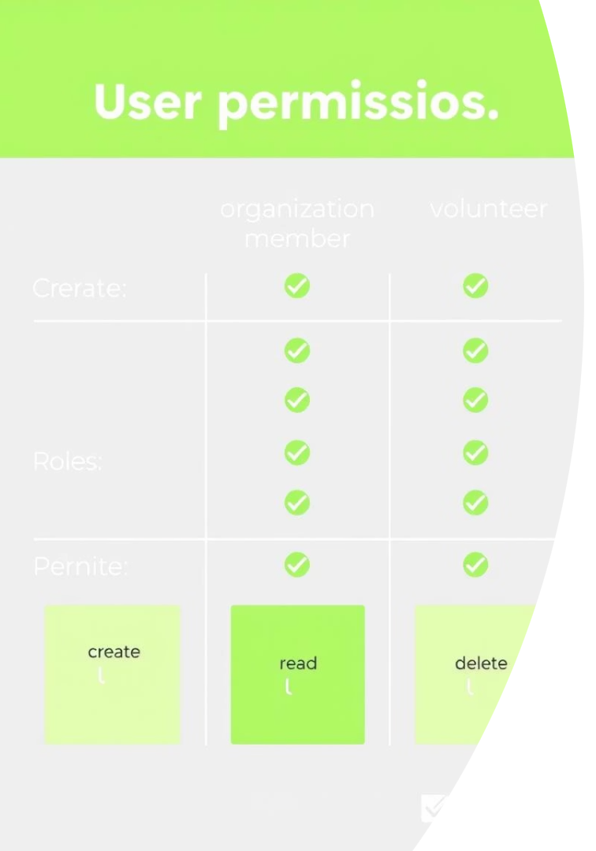
Permissions Matrix
Action
Admin
Organization
Volunteer
Register/Login
✅
✅
✅
Create/Edit Events
❌
✅
❌
Browse Events
✅
✅
✅
Join Events
❌
❌
✅
Approve Volunteers
❌
✅
❌
Provide Feedback
✅
✅
✅
Export Reports
✅
✅
❌
Block/Unblock Users
✅
❌
❌

